Slide 1
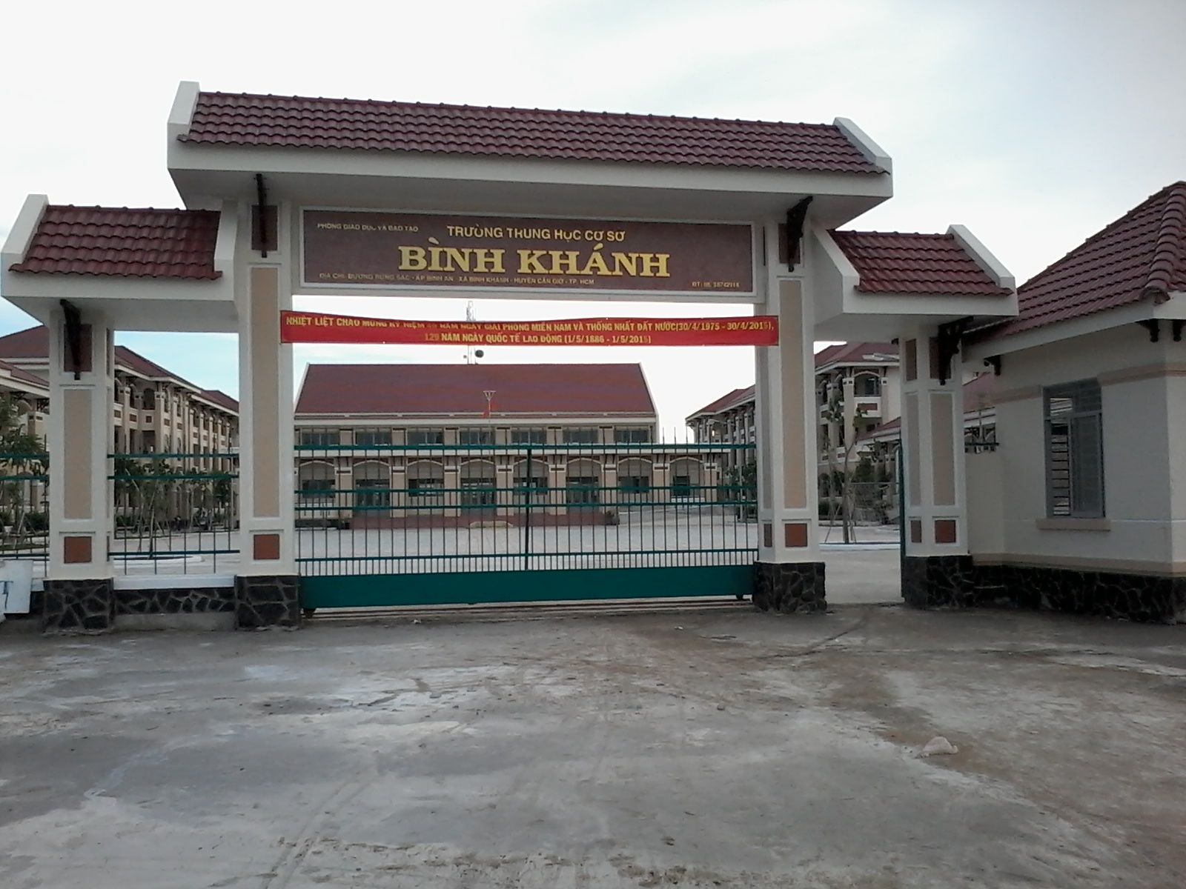



BINH KHANH SECONDARY SCHOOL
FRIENDS PLUS 6

Slide 2

BACK TO THE BOARD

Slide 3
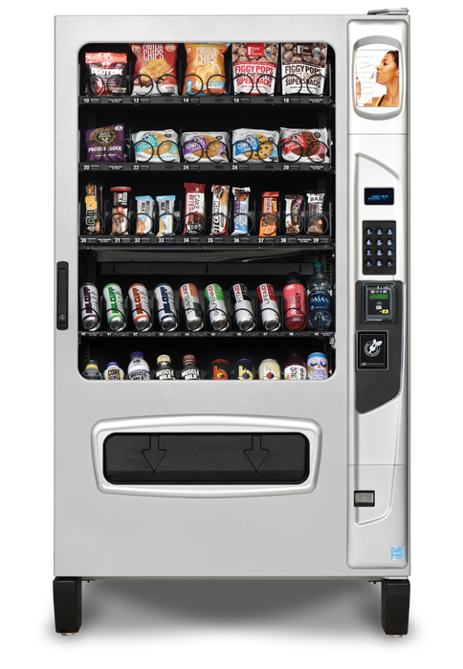
Vending machine

Slide 4
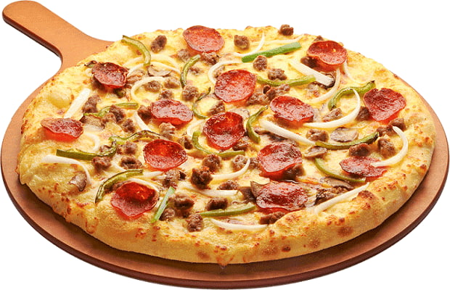
Pizza

Slide 5
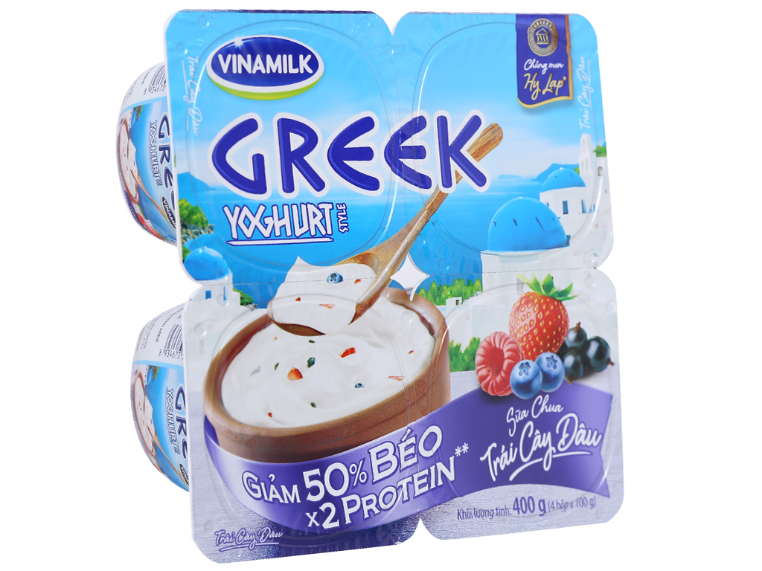
Yoghurt

Slide 6
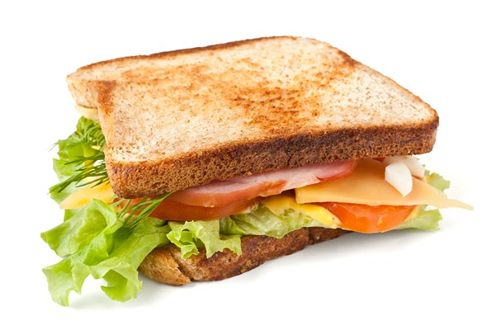
Sandwich

Slide 7
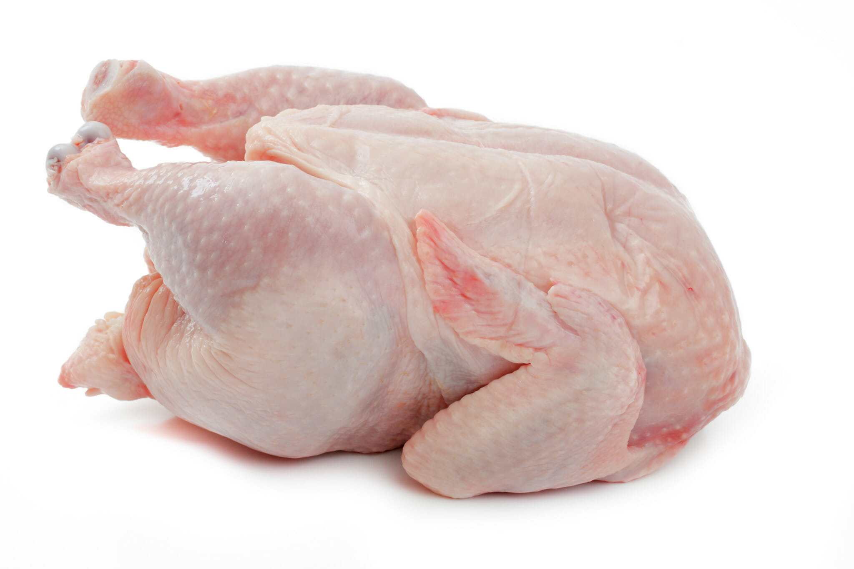
Chicken

Slide 8
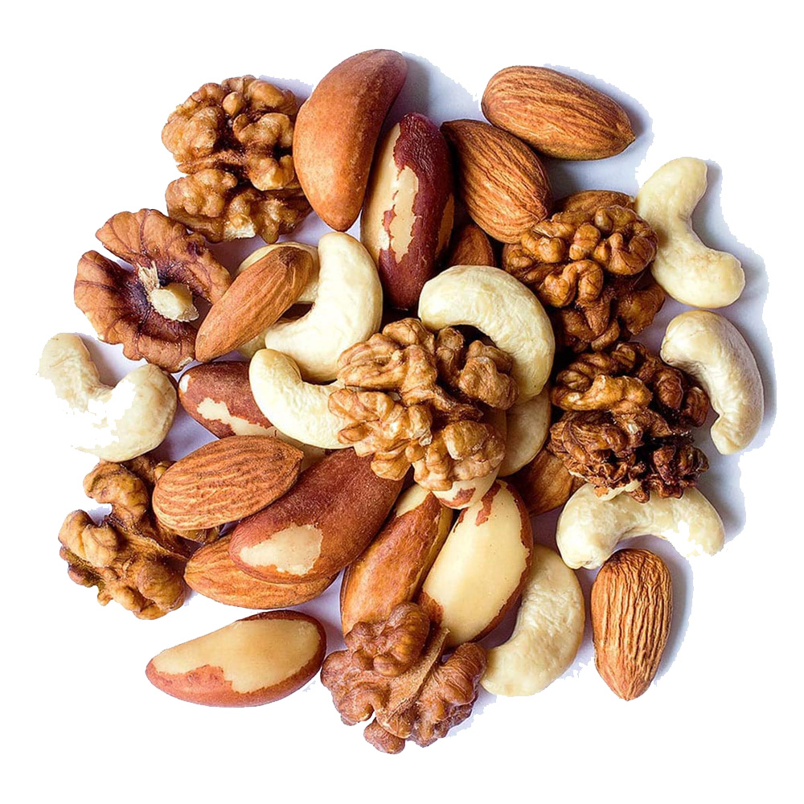
Nuts

Slide 9
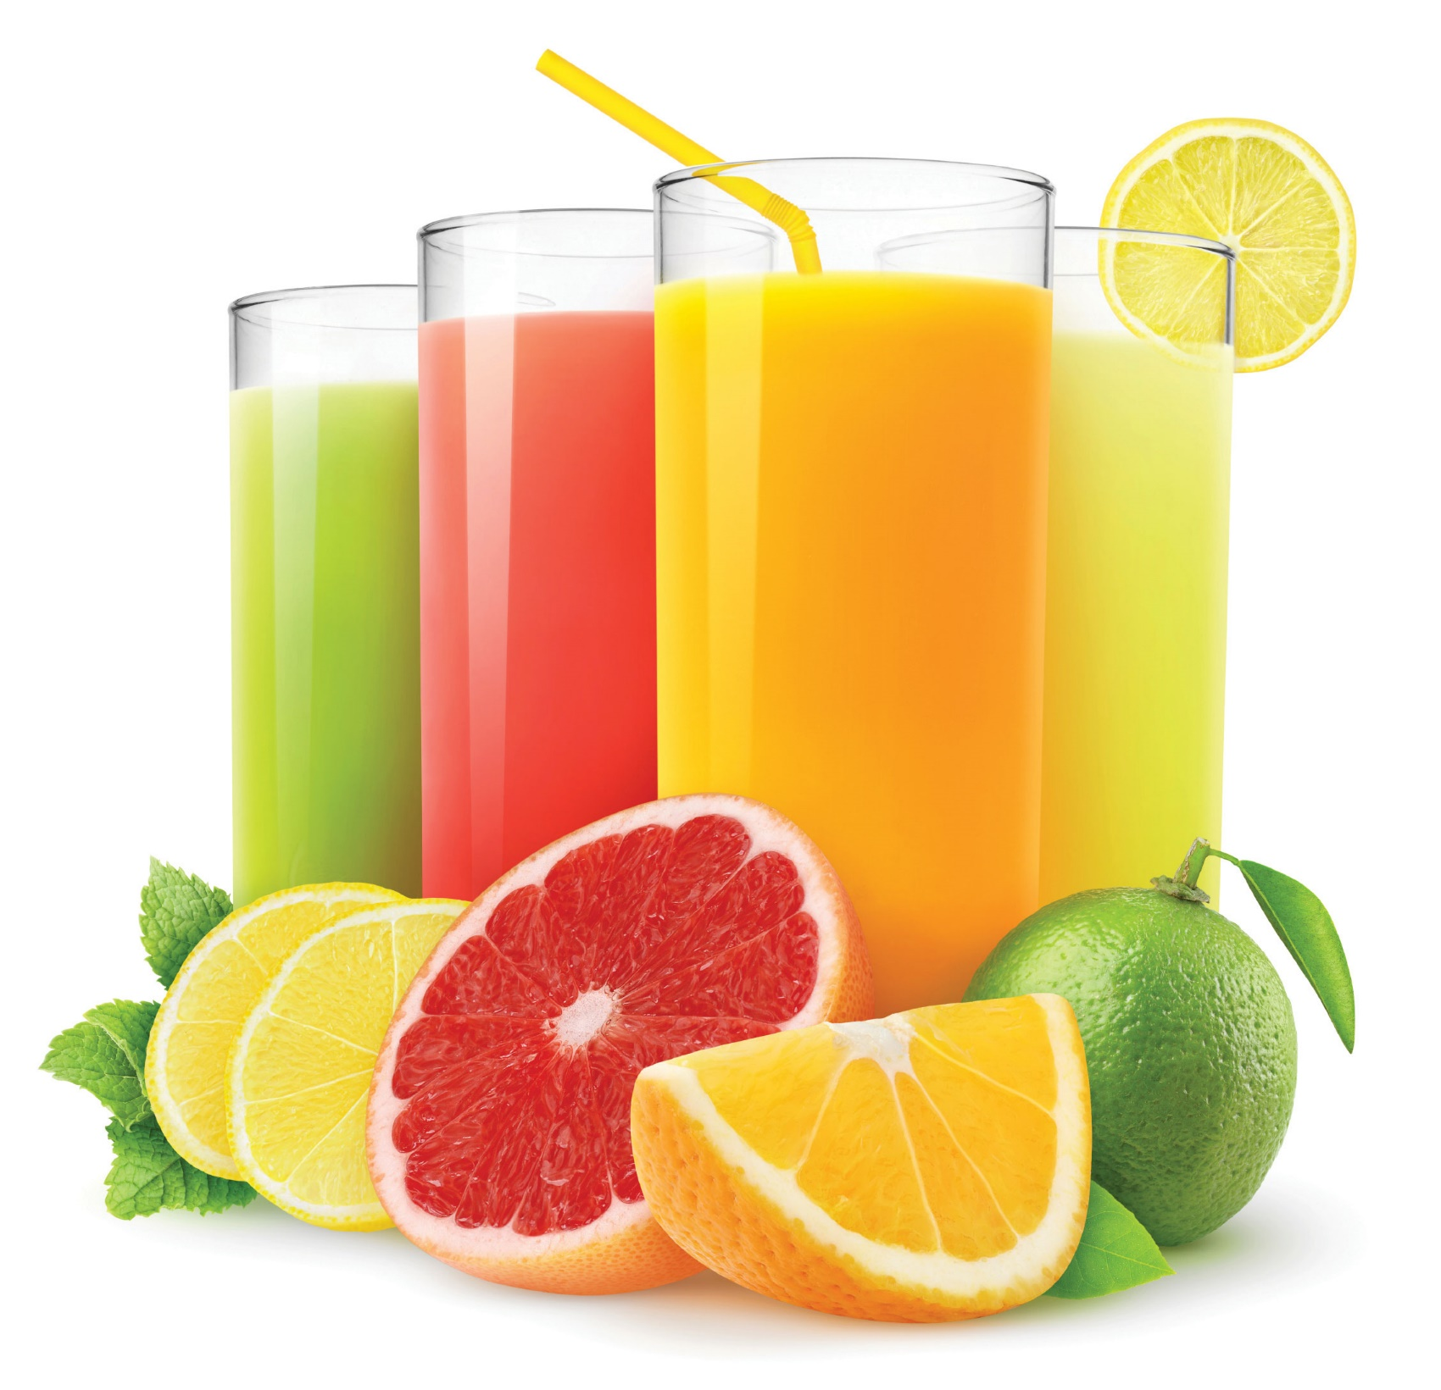
Juice

Slide 10
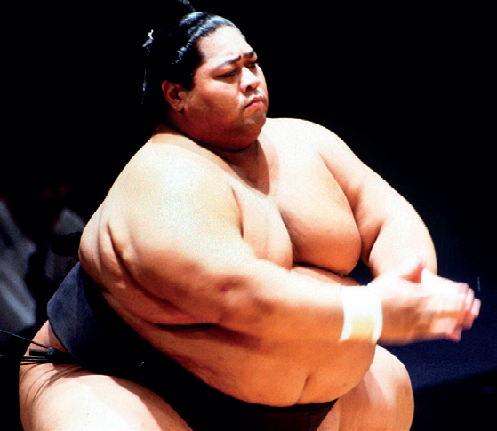
What does the man do?
What do you know about a sumo wrestler?

Slide 11
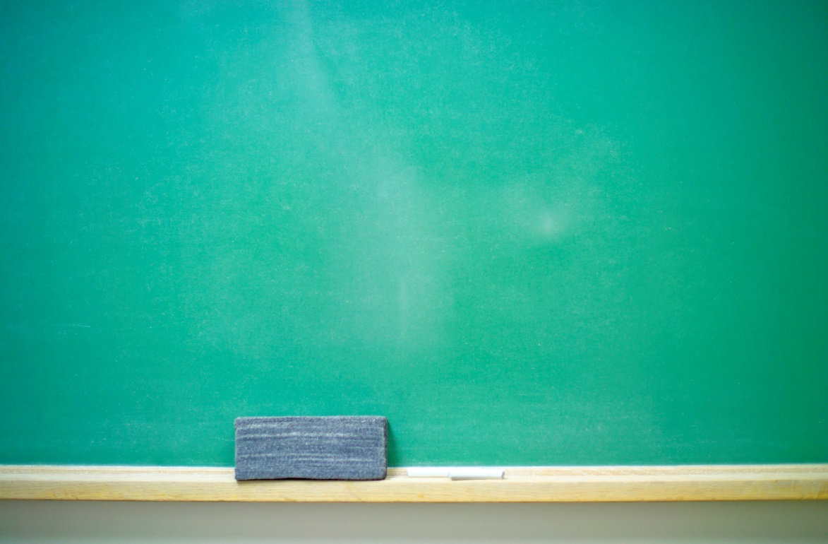
UNIT 4
food and health
Lesson 2: READING
- SUMO WRESTLERS

Slide 12
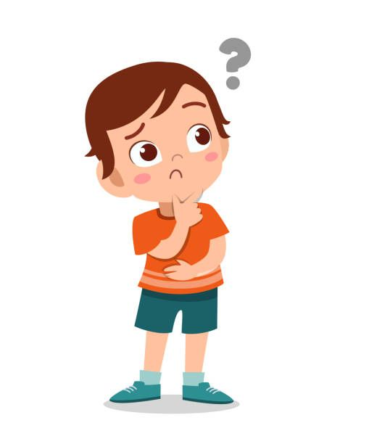
TRUE or FALSE?

Slide 13
TRUE – FALSE QUIZ
Most sumo wrestlers weigh 190 kilos.
2) Sumo wrestlers start training early in the morning.
3) They have a big breakfast.
4) There’s a lot of fat in chankonabe.
5) They sometimes eat sweet foods.

Slide 14


Slide 15
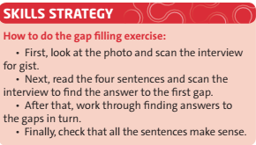

Slide 16
Read the text. Complete the interview with questions a – d.

Slide 17
The sports interview .... SUMO STYLE
Those sumo wrestlers are big! How much do they weigh? Most top wrestlers weigh more than 140 kilos. The heaviest are around 190 kilos. Is it a popular sport? Well, there aren’t many sumo wrestlers these days. It isn’t a healthy lifestyle. (1) _________________________ They get up early and train from 5 a.m. until about 1 p.m. What do they have for breakfast? They don’t have breakfast – so they’re very hungry at lunchtime and they eat a lot! 2) ____________________________ They have a special dish called chankonabe. There’s a lot of meat or fish in chankonabe and there are also a lot of vegetables.
What’s their typical day?
What do they have for lunch?

Slide 18
Is it healthy?
(3) __________________
Well, it’s full of vitamins and there isn’t much fat in it, but they eat enormous quantities – sometimes six or seven bowls – and then maybe five bowls of rice.
But they exercise a lot.
Yes, but not after meals. After lunch they sleep, then they get up and eat more me chankonabe.
4) ________________________________
Yes, some eggs, salads, some desserts maybe; but always chankonabe.
So, if you want to be sumo size, eat and sleep a lot. If not, maybe do sports which are healthier!
Do they ever eat any different foods?

Slide 19
Listen to the text again and complete the summary with five of the words in the box

Slide 20

eat
is
before
healthy
mornings
sleep
isn’t
after
unhealthy
afternoons
The lifestyle of sumo wrestlers 1) ___________ normal. The food which they eat is 2) _______________ , but they 3) _________a lot. They also sleep a lot in the 4) ________________and they don’t exercise 5) ______________ meals.

Slide 21
TRUE – FALSE QUIZ
Most sumo wrestlers
F
1) Only the heaviest sumo wrestlers
weigh 190 kilos.
2) Sumo wrestlers start training early in the morning.
T
F
3) They
don’t have
have
a big breakfast.
F
4) There isn’t much fat
4) There’s a lot of
in chankonabe.
T
5) They sometimes eat sweet foods.

Slide 22
Vocabulary Plus

Slide 23
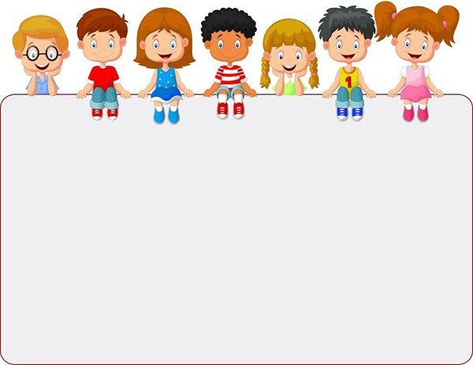
Use a dictionary to check the meanings of the words in blue in the text.

Slide 24
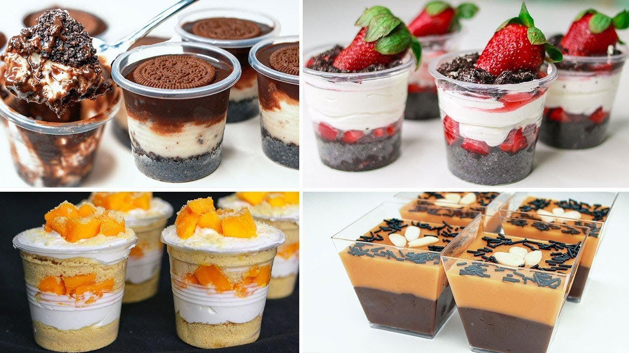
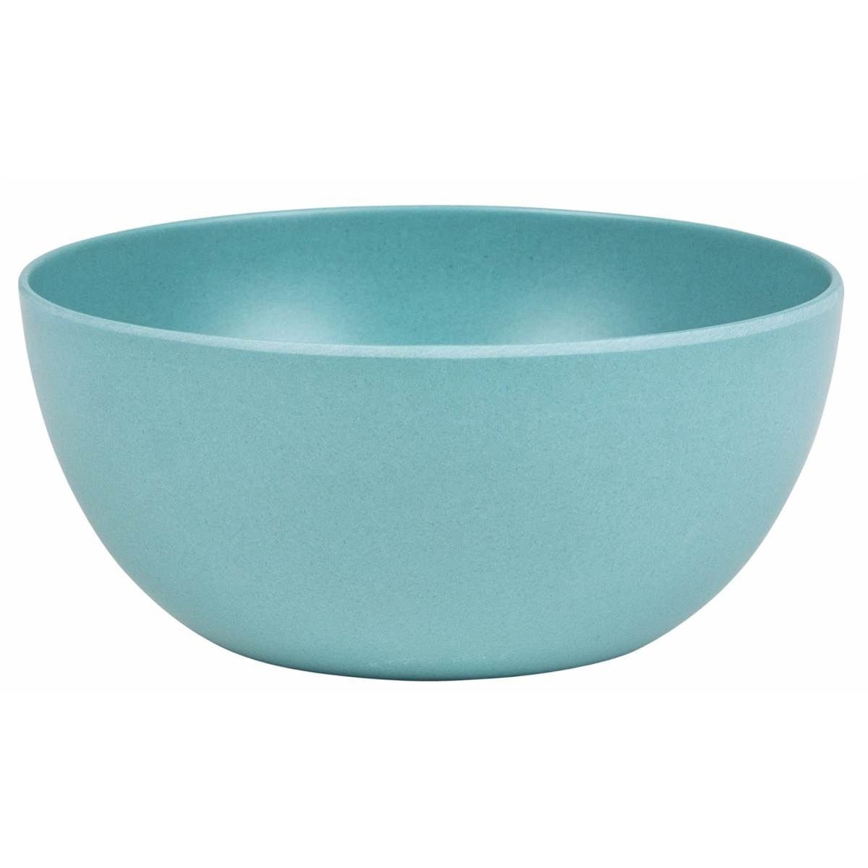
New words
- dessert (n) /dɪˈzɜːt/
: sweet food eaten at the end of a meal
- to train (v) /treɪn/
: to exercise or to practise
Ex: I train in the gym for two hours a day.
- enormous (adj) /ɪˈnɔːməs/
: very big or huge.
Ex: Their garden is enormous.
- bowl (n) /bəʊl/
- vitamin (n) /ˈvɪtəmɪn/
: a chemical substance in food that is necessary for good health
Ex: There are lots of vitamins in vegetables.
- dish (n) /dɪʃ/
: food prepared in a particular way as part of a meal.

Slide 25
VOCABULARY PLUS

Slide 26
Complete the sentences with the correct blue words from the text.
___________ are good for you.
Sports people usually _______ every day.
Spaghetti bolognese is a popular _________ in Italy.
You have _________ at the end of a meal.
You put rice or soup in a ________.
Vitamins
train
dish
desserts
bowl

Slide 27
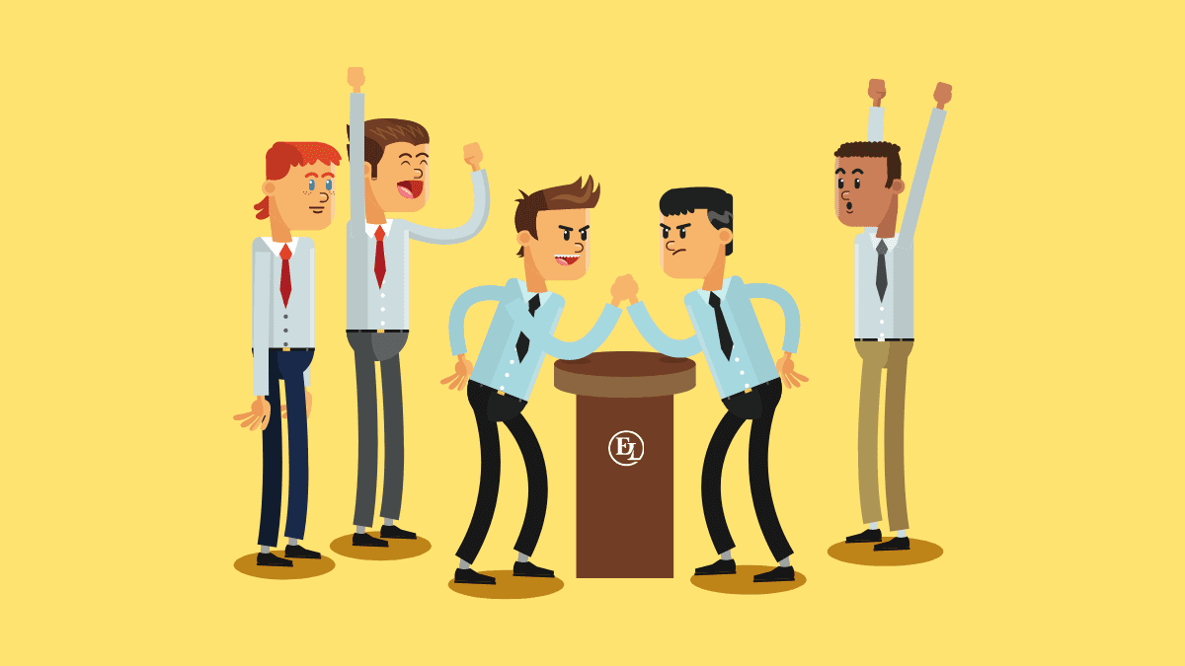
Question battle

Slide 28

RULES
Makes 5 questions related to the content in the lesson.
After finishing making questions, the whole class put away all the books, each member of each team will take turns reading out a question for the other team to answer.
In 1 minute, if the opposite team cannot answer, the asking team will get points. The team that has the most answers will win.

Slide 29
Example:
How long do sumo wrestlers train in a day?
What is the special dish for them?

Slide 30
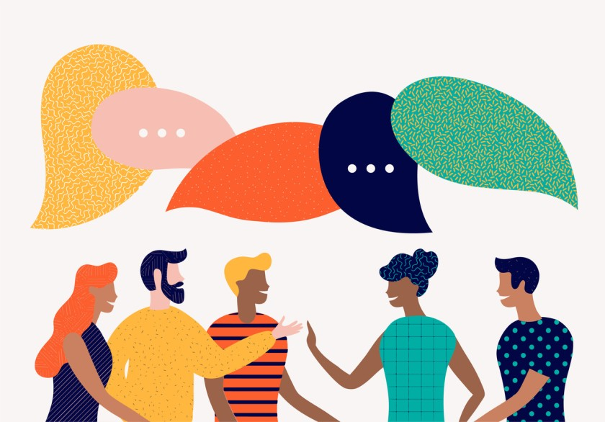
DISCUSSION

Slide 31
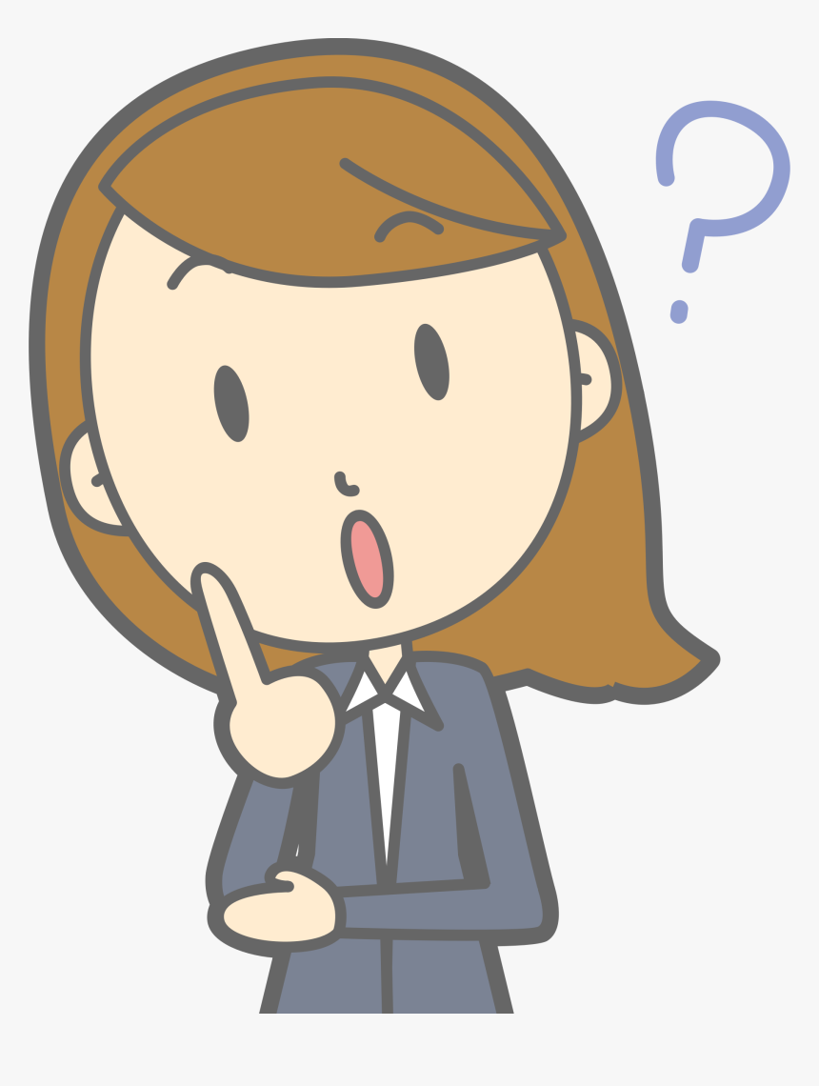
Do you think a sumo wrestler’s life is interesting? Why / Why not?

Slide 32
What is your favourite dish?

Slide 33
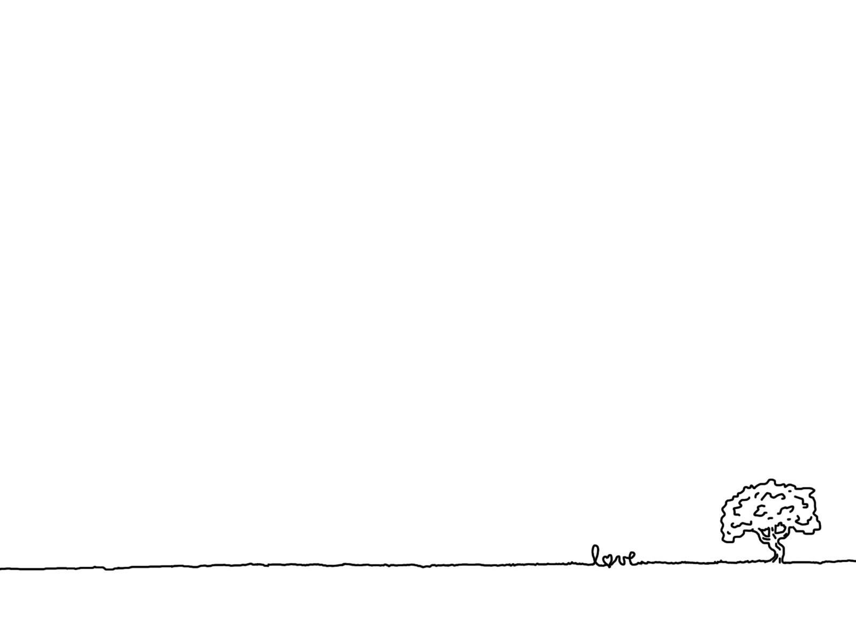
Homework
Learn by heart all the new words.
Read Skill strategy.
Workbook: exercises 1, 2/ p.40
Draw and color a picture of your favorite food.

